Slide 1
18CSC202J - Syllabus
Unit 3 :
Single and Multiple Inheritance - Multilevel inheritance - Hierarchical - Hybrid Inheritance - Advanced Functions - Inline - Friend - Virtual -Overriding - Pure virtual function -Abstract class and Interface -UML State Chart Diagram - UML Activity Diagram

Slide 2


Inheritance
Inheritance is the capability of one class to acquire properties and characteristics from another class. The class whose properties are inherited by other class is called the Parent or Base or Super class. And, the class which inherits properties of other class is called Child or Derived or Sub class.
01
Definition
02
Syntax
Single Inheritance, Multiple Inheritance, Hierarchical Inheritance, Multilevel Inheritance, and Hybrid Inheritance (also known as Virtual Inheritance)
Note : All members of a class except Private, are inherited
03
Types
Code Reusability
Method Overriding (Hence, Runtime Polymorphism.)
Use of Virtual Keyword
04
Advantages

Slide 3
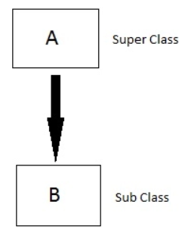
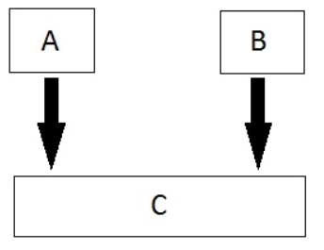
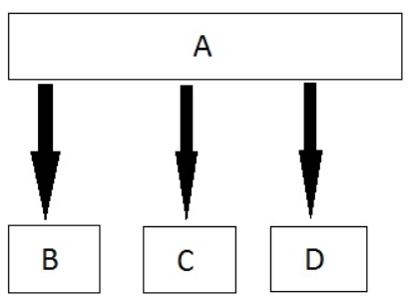
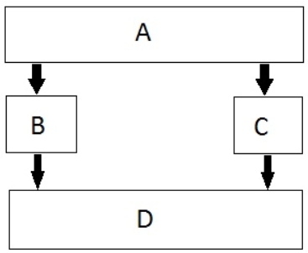
Inheritance Types
01
Single
02
Multiple
03
Hierarchical
04
Multilevel
05
Hybrid

Slide 4
Modes of Inheritance
If we derive a sub class from a public base class. Then the public member of the base class will become public in the derived class and protected members of the base class will become protected in derived class
01
Public
If we derive a sub class from a Protected base class. Then both public member and protected members of the base class will become protected in derived class.
02
Protected
If we derive a sub class from a Private base class. Then both public member and protected members of the base class will become Private in derived class.
03
private
The private members in the base class cannot be directly accessed in the derived class, while protected members can be directly accessed. For example, Classes B, C and D all contain the variables x, y and z in below example
Note:

Slide 5
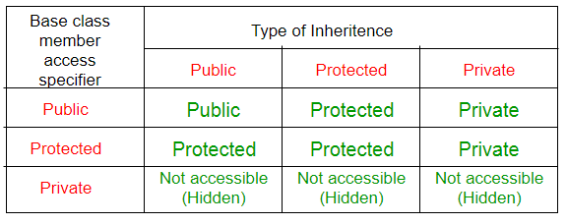
Inheritance Access Matrix

Slide 6
SINGLE INHERITANCE
Example
Base Class
ClassA
Base Class
Derived Class
Class B
Derived Class

Slide 7
Single Inheritance
In single inheritance, a class is allowed to inherit from only one class. i.e. one sub class is inherited by one base class only. Based on the visibility mode used or access specifier used while deriving, the properties of the base class are derived. Access specifier can be private, protected or public.
Syntax:
class Classname // base class
{
..........
};
class classname: access_specifier baseclassname
{
…
};

Slide 8
Example
#include <iostream>
using namespace std;
class base //single base class
{ public:
int x;
void getdata()
{
cout << "Enter the value of x = ";
cin >> x;
}
};
class derived : public base //single derived
{
int y;
public:
void readdata()
{
cout << "Enter the value of y = ";
cin >> y;
}
void product()
{
cout << "Product = " << x * y;
}
};
int main()
{
derived a; //object of derived class
a.getdata();
a.readdata();
a.product();
return 0;
}

Slide 9
Applications of Single Inheritance
Grading System
University Grading System
Employee and Salary
Student

Slide 10
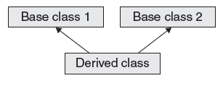
Multiple Inheritance
Base Class
Base Class

Slide 11
Multiple Inheritance
In this type of inheritance a single derived class may inherit from two or more than two base classes.
Syntax:
class A // base class
{
..........
};
class B
{
..........
}
class c : access_specifier A, access_specifier B // derived class
{
...........
} ;

Slide 12
Example:
#include using namespace std;
class sum1
{
protected: int n1;
};
class sum2
{
protected: int n2;
};
class show : public sum1, public sum2
{
public: int total()
{
cout<<“enter n1”;
cin>>n1;
cout<<“enter n2″;
cin>>n2;
cout<<“sum=”<
cout<<“sum=”<<n1+n2<<endl;
}
};
int main()
{
show ob;
ob.total();
}

Slide 13
Applications of Multiple Inhertiance
Distributed Database

Slide 14
Multilevel Inheritance
A derived class can be derived from another derived class. A child class can be the parent of another class.
Syntax:
class A // base class
{
..........
};
class B
{
..........
}
class C : access_specifier B
// derived class
{
...........
} ;

Slide 15
// base class
class Vehicle
{
public:
Vehicle()
{
cout << "This is a Vehicle";
}
};
class fourWheeler: public Vehicle
{ public:
fourWheeler()
{
cout<<"Objects with 4 wheels are vehicles"<<endl;
}
};
// sub class derived from two base classes
class Car: public fourWheeler{
public:
car()
{
cout<<"Car has 4 Wheels”;
}
};
// main function
int main()
{
//creating object of sub class will
//invoke the constructor of base classes
Car obj;
return 0;
}

Slide 16
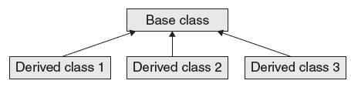
Hierarchical Inheritance

Slide 17
Hierarchical Inheritance
In this type of inheritance, more than one sub class is inherited from a single base class. i.e. more than one derived class is created from a single base class.
Syntax:
class A // base class
{
};
class B : access_specifier A
{
} ;
class C : access_specifier A
{
} ;
class D : access_specifier A
{
} ;

Slide 18
Example
#include <iostream>
using namespace std;
class A //single base class
{
public:
int x, y;
void getdata()
{
cout << "\nEnter value of x and y:\n";
cin >> x >> y;
}
};
class B : public A //B is derived from class base
{
public:
void product()
{
cout << "\nProduct= " << x * y;
}
};
class C : public A //C is also derived from class base
{
public:
void sum()
{
cout << "\nSum= " << x + y;
}
};
int main()
{
B obj1; //object of derived class B
C obj2; //object of derived class C
obj1.getdata();
obj1.product();
obj2.getdata();
obj2.sum();
return 0;
}

Slide 19
Order of Constructor Call
Base class constructors are always called in the derived class constructors. Whenever you create derived class object, first the base class default constructor is executed and then the derived class's constructor finishes execution.
Points to Remember
Whether derived class's default constructor is called or parameterised is called, base class's default constructor is always called inside them.
To call base class's parameterised constructor inside derived class's parameterised constructor, we must mention it explicitly while declaring derived class's parameterized constructor.

Slide 20
Example
class Base
{
int x;
public:
Base()
{
cout<<"Base default constructor";
}
};
class Derived : public Base
{
int y;
public:
Derived()
{
cout<"Derived def. constructor";
}
// parameterized constructor
Derived(int i)
{
cout << "Derived parameterized constructor\n";
}
};
int main()
{
Base b;
Derived d1;
Derived d2(10);
}

Slide 21
Order of Constructor Call
class Base
{
int x;
public:
// parameterized constructor
Base(int i)
{
x = i;
cout<<"BaseParameterized Constructor\n";
}
};
class Derived : public Base
{
int y;
public:
// parameterized constructor
Derived(int j):Base(j)
{
y = j;
cout << "Derived Parameterized Constructor\n";
}
};
int main()
{
Derived d(10) ;
}
Example:

Slide 22
Note:
Constructors have a special job of initializing the object properly. A Derived class constructor has access only to its own class members, but a Derived class object also have inherited property of Base class, and only base class constructor can properly initialize base class members. Hence all the constructors are called, else object wouldn't be constructed properly.

Slide 23
Constructors and Destructors are never inherited and hence never overridden.
Also, assignment operator = is never inherited. It can be overloaded but can't be inherited by sub class.
Concept
01
They are inherited into the derived class.
If you redefine a static member function in derived class, all the other overloaded functions in base class are hidden.
Static Member functions can never be virtual.
02
Static Function
Derived class can inherit all base class methods except:
Constructors, destructors and copy constructors of the base class.
Overloaded operators of the base class.
The friend functions of the base class.
03
Limitation

Slide 24
Calling base and derived class method using base reference
Example:
#include <iostream>
using namespace std;
class Foo
{
public:
int x;
virtual void printStuff()
{
cout<<"BaseFoo printStuff called"<<endl;
}
};
class Bar : public Foo
{
public:
int y;
void printStuff()
{
cout<<"derived Bar printStuff called"<<endl;
}
};
int main()
{
Foo *foo=new Foo;
foo->printStuff();/////this call the base function
foo=new Bar;
foo->printStuff();
}
Output:
Base Foo printStuff called
derived Bar printStuff called

Slide 25
Calling base and derived class method using derived reference
Example:
#include <iostream>
class Base{
public:
void foo()
{
std::cout<<"base";
}
};
class Derived : public Base
{
public:
void foo()
{
std::cout<<"derived";
}
};
int main()
{
Derived bar;
//call Base::foo() from bar here?
bar.Base::foo(); // using a qualified-id
return 0;
}
Output:
base

